Slide 1

What is Playwright
A quick overview about Playwright

Slide 2
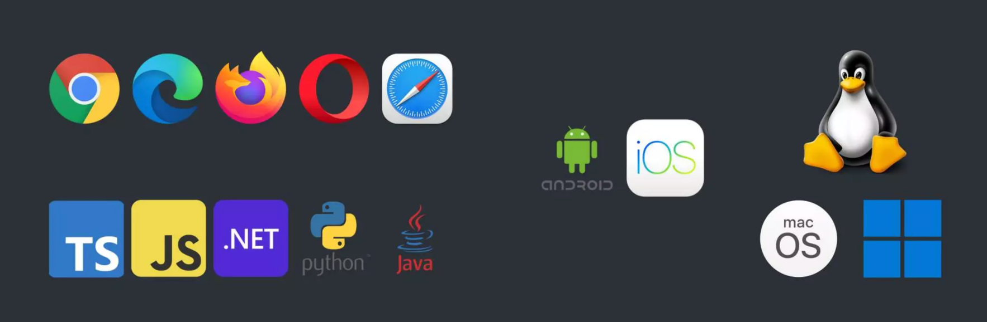
Playwright?
Playwright is a E2E open source testing and automation framework for modern web app that allow you to run automated test in multiple platforms, browsers, using the programming language of your choice

Slide 3
Why Playwright?
Playwright creates a new browser profile (context) for each test, which deliver full test isolation with zero overhead. We can save context to login once and reuse in different test
Playwright waits for element to be actionable before performing any action, so it removes the need of artificial debounce to ensure the tests are not logging false positives.
Playwright can retry test and capture the execution trace with code videos or screenshots using the Trace Viewer to review and resolve them

Slide 4
Playwright vs Selenium

Slide 5
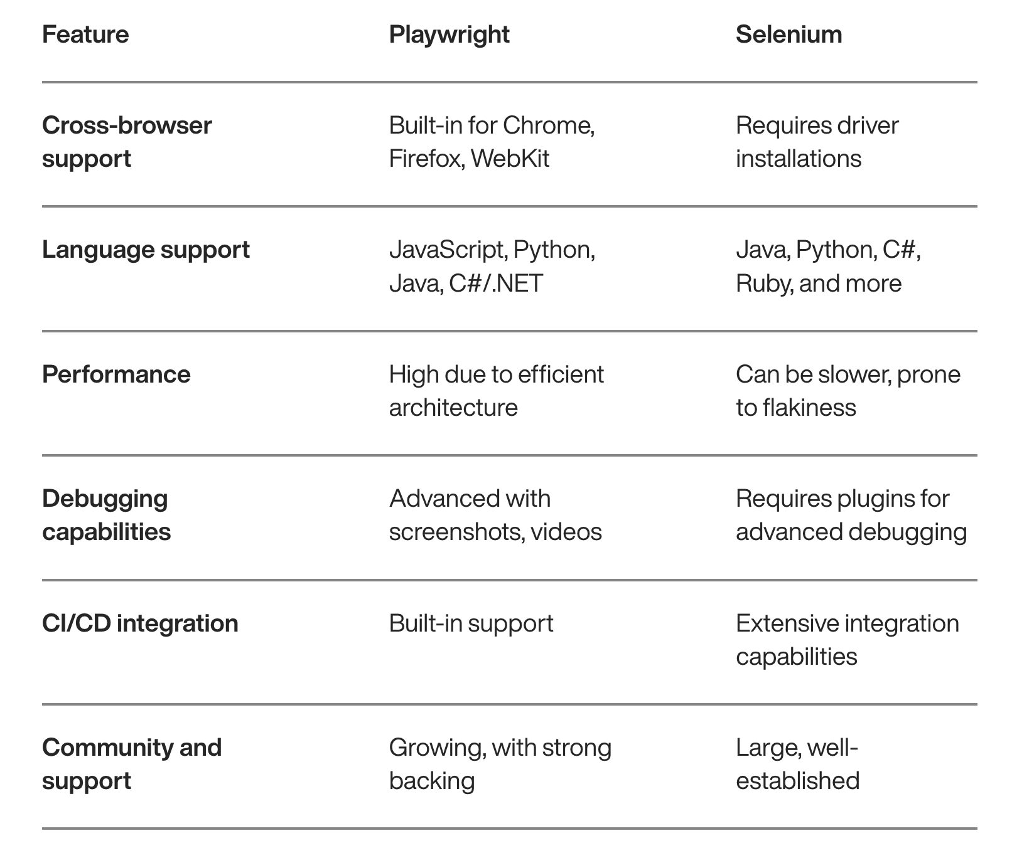

Slide 6
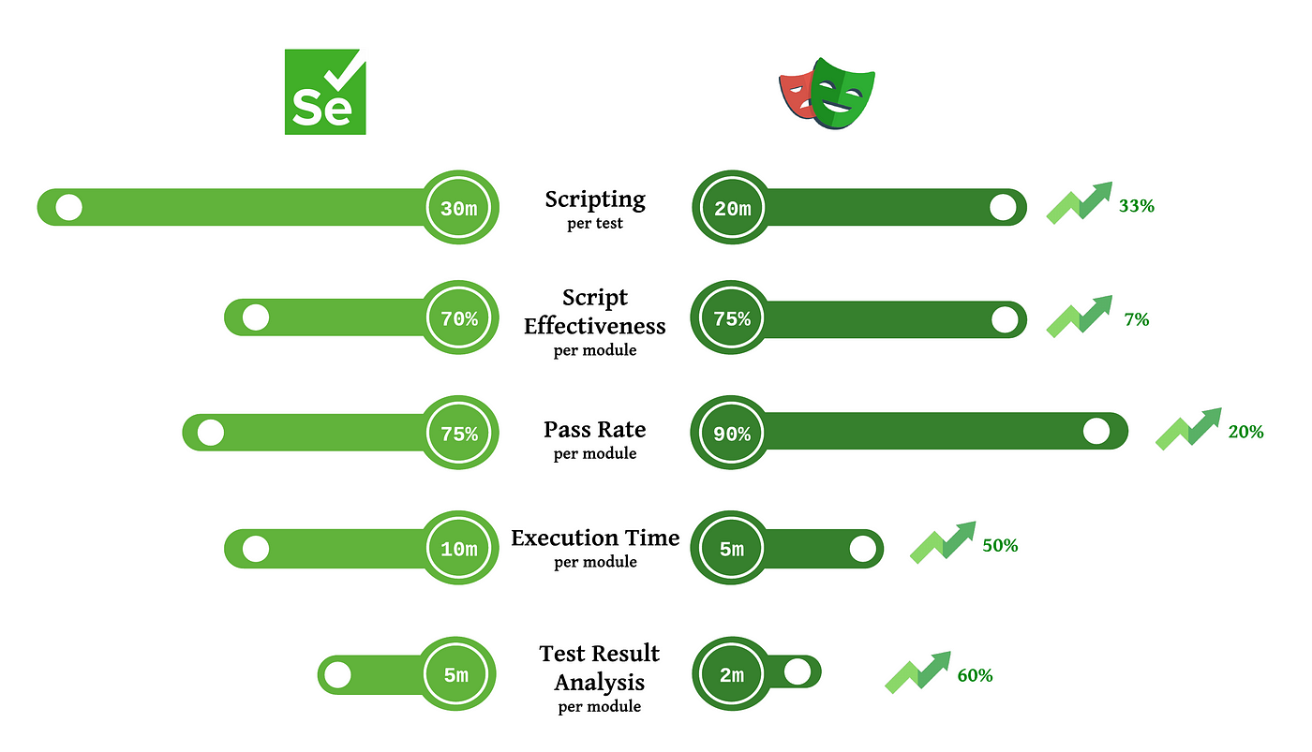

Slide 7
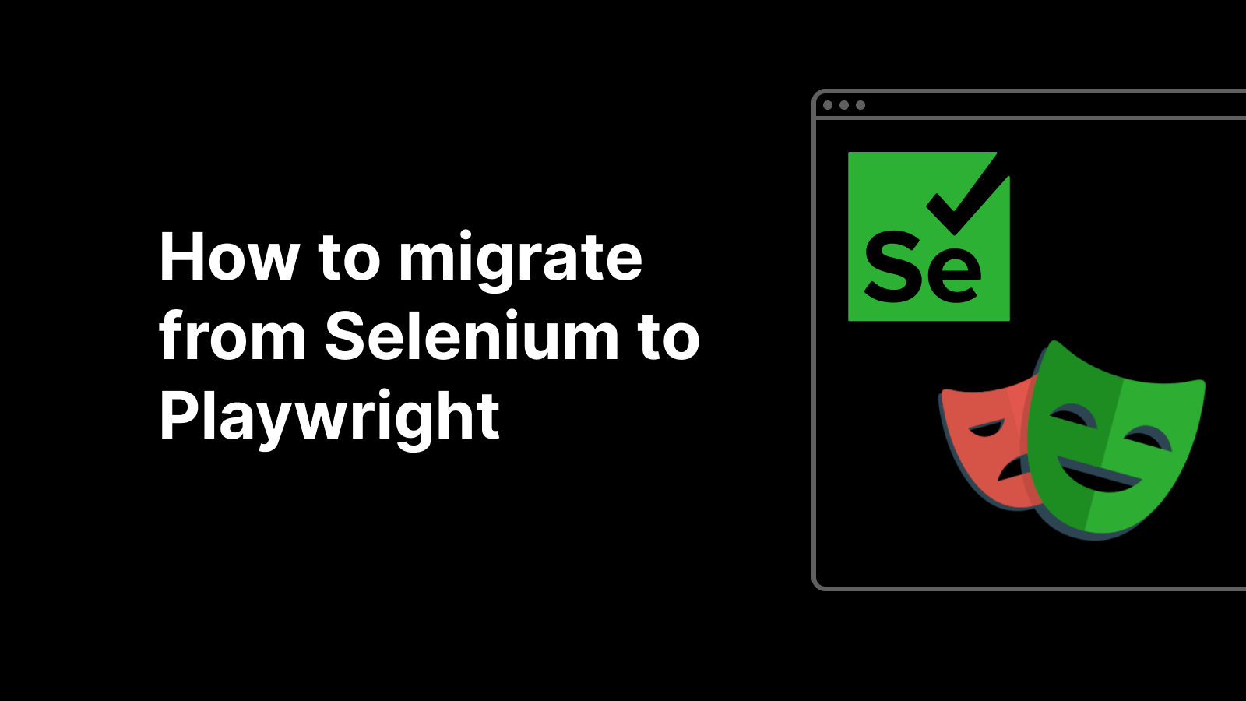
Playwright conversion
From Selenium

Slide 8
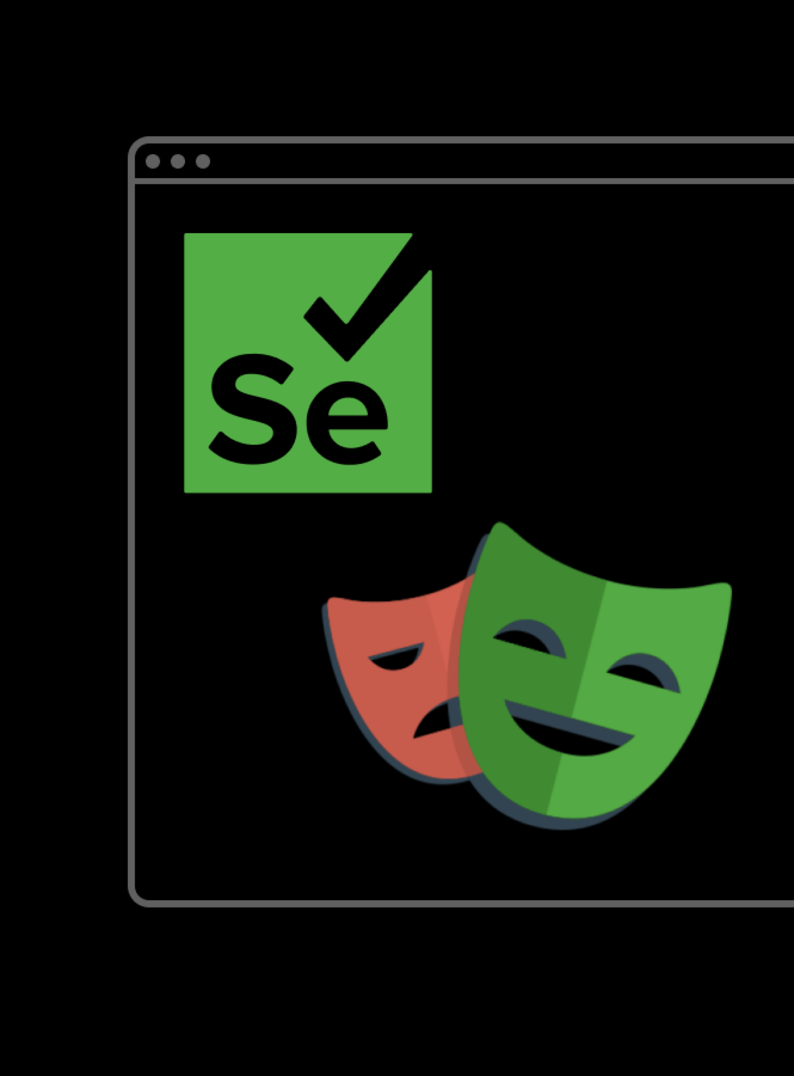
Set Up Playwright: Install Playwright and set up your environment.
Create a Basic Playwright Script: Start by writing a simple Playwright script to open a browser, navigate to a page, and perform basic actions. This will help you get familiar with the basic structure and commands.
Map Selenium Commands to Playwright: Identify the Selenium commands in your scripts and find their Playwright equivalents. For instance, translating Selenium's findElement to Playwright's page.locator, we've shared a few below to help you get an idea of the most basic ones.

Slide 9
Handle Waits and Asynchrony: Adjust your scripts to handle Playwright’s automatic waiting and the async nature of its API. Replace explicit waits from Selenium with Playwright's auto-wait features.
Implement Advanced Features: If your Selenium scripts use advanced features like handling iframes, file uploads, or downloads, learn how Playwright handles these scenarios.
Run and Debug: Run your Playwright scripts and debug any issues. Pay special attention to timing issues or element selectors that might behave differently in Playwright.

